Slide 1
StockEx
WAHAJ AMEEN
AFFAN NAEEM
SYED SHAYAN PASHA

Slide 2
INTRODUCTION
StockEx is a stock trading platform that allows users to buy, sell and invest in stocks and securities in the free market.

Slide 3
MOTIVATION
Gain experience in a key OOP area – object relation and interaction.
Gain valuable experience in data storage and database management using SQL.
Learn simplistic GUI design with Qt.

Slide 4
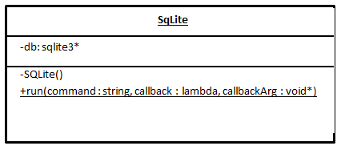
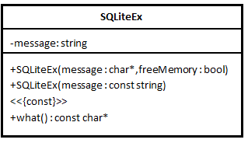
DATABASE MANAGEMENT
SQL implementation used: sqlite3
Wrapped C library with OOP principles.
Developed a new exception class for error handling.

Slide 5
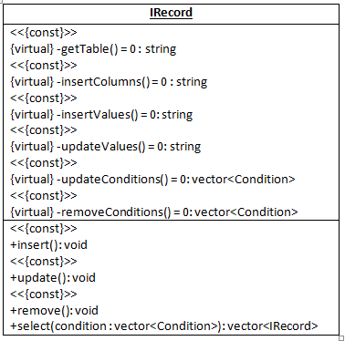
OBJECT-DATABASE INTERACTION
Developed a standard interface
for object-database
interaction – IRecord.
Ensures code reuse and
uniform object behaviour.

Slide 6
IRECORD DERIVED CLASSES
A total of 7 classes are derived from the IRecord interface class.
Each class maps to a separate table in the database and implements full database functionality.
IRecord inheritance allows the data control classes – primarily RealTime and User – to interact with all database objects easily

Slide 7
DATA CONTROL CLASSES
Each database object has complete control of its data.
To facilitate interaction and communication between database objects, we use data control classes User and RealTime.
Following OOP principles, RealTime and User serve as data holders, and not data processors.

Slide 8
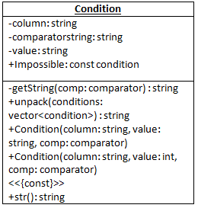
CONDITION
Helper class that allows to
easily build conditions used
in SQL queries.
Ensures uniform condition
building across the codebase.

Slide 9
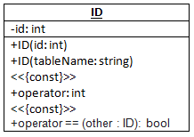
ID
A class to hold primary keys
which are based on sqlite3's
Autoincrement feature.
Ensures that the correct ID
is selected from the database
when such objects are created.

Slide 10
UTIL. hpp
Provides an exception handling macro and two template functions that are used throughout the project to build SQL queries.
The Expects macro is used to make exception throwing
concise, standard, and readable.
Build and quote are used to write syntactically correct SQL queries using variadic templates.

Slide 11
STANDARD LIBRARY
The project makes extensive use of the C++ standard template library, in particular its data structures and algorithms.
std::vector, std::map, std::set and std::list are used where appropriate.

Slide 12
CODE OPTIMIZATION
Copious use of static variables where possible.
All eligible functions declared const.
All exception-safe functions declared noexcept.
Parameters passed by const-reference where possible.
Runtime polymorphism is kept to a minimum - leveraging C++'s static linking speed.

Slide 13
CODING STYLE PHILOSOPHY
Code should be self documenting.
Comments used only where necessary.
Conventionally and clearly named variables and functions.

Slide 14
API-STYLE INTEGRATION
Backend and frontend were developed as standalone.
Proper data encapsulation provides error-safe data access across interface and backend.

Slide 15
Class Design Patterns
Singleton
Unique object
Templatized data retrieval

Slide 16
EXCEPTION HANDLING
Large portions of the code are noexcept.
The majority of the exception handling is done on the frontend - following the nothrow design principle.
Use of an Expects macro to standardize exception creation across the project.

Slide 17
DATA FLOW
Encapsulation is enforced throughout the codebase.
Every object assumes complete ownership of its data.
Objects interact by invoking appropriate methods, instead of direct data access.

